Slide 1


SoundSOS
Daniel Ohayon
Tal Levinzon
Supervisor 1: Mrs. Elena Kremer
Supervisor 2: Dr. Dan Lemberg

Slide 2
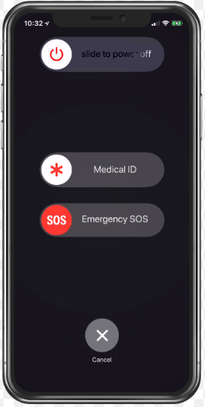

Background
Currently
Call the police.
Press the emergency button.
Our solution
Always running in the background for recording and analysis.
Based on the analysis results:
The system automatically calls the emergency number
The system saves the audio file
Notes:
So, I'll start with a small overview.
Cases of distress have become more common, leading to poor quality of life and, in severe cases, death. A case for example is dangerous violence between couples.
These days, the typical response to feeling threatened is to call the police or activate an emergency alert by button press.
The issue with current solutions is the loss of access to the device in an emergency, which can be problematic as time is a critical factor in saving lives.
So, we came to solve this issue,
Our application provides an innovative solution for emergency situations,
by using advanced voice recognition technology to activate the system.
This cancels the need for physical activation, which can be difficult or impossible in certain scenarios.
This solution allows for quick and efficient response in times of distress.

Slide 3
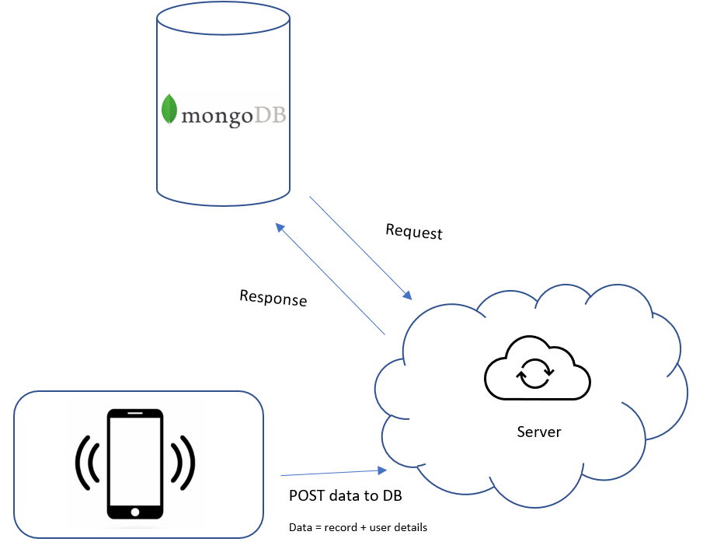
How does it work?
Phone application that runs in the background and records and analyzes audio.
The server is synchronized with the DB, for all our calculations which analyze audio.
Notes:
Let's discuss about how it works,
We developed an application which runs in the background and records and analyzes audio.
The meaning of analysis audio is to check his features by Models of CNN architecture. First, we need to check if the voice belongs to the user and if so, check his emotion.

Slide 4

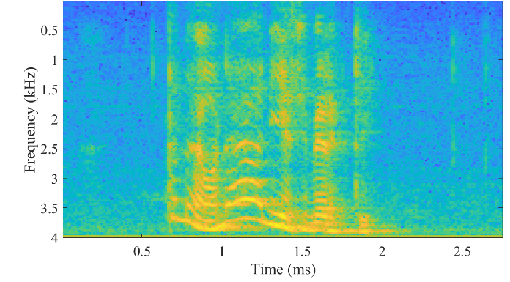
CNN – UNIQUE VOICE CLASSIFICATION
Model: “VGGVox”
Input layer:
A spectrogram of height 512 and width can accommodate audio signals of varying durations
:
Output layer :
A dense layer, (connects every neuron from the previous layer to every neuron in the current layer)
The dense layer has 630 units.
:
Notes:
Deep learning model designed for speaker verification/recognition.
It extends the VGGNet architecture for audio processing.
By using convolutional and fully connected layers, it extracts discriminative features from spectrograms/MFCCs.
The model learns to recognize unique vocal characteristics while being robust to speaker variations.
Trained on labeled audio data, VGGVox achieves top performance in speaker verification, showcasing its effectiveness in capturing speaker-specific information from audio signals.

Slide 5
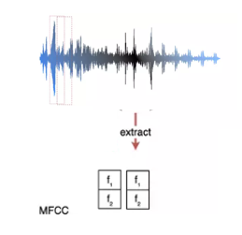

CNN – eMOTION VOICE CLASSIFICATION
Model: “Sequential”
Input layer:
Extracted MFCC features can be used as inputs. Is the input to the convolutional layer.
:
Output layer :
A dense layer, (connects every neuron from the previous layer to every neuron in the current layer)
The dense layer has 10 units – emotion male/female.
:
Notes:
Deep learning model designed for speaker verification/recognition.
It extends the VGGNet architecture for audio processing.
By using convolutional and fully connected layers, it extracts discriminative features from spectrograms/MFCCs.
The model learns to recognize unique vocal characteristics while being robust to speaker variations.
Trained on labeled audio data, VGGVox achieves top performance in speaker verification, showcasing its effectiveness in capturing speaker-specific information from audio signals.
the first layer is a 1D convolutional layer (Conv1D) that takes the extracted MFCC features as input. The MFCC features are represented as a 2D array with shape (num_frames, num_mfcc_coefficients), where num_frames represents the number of frames in the audio and num_mfcc_coefficients represents the number of MFCC coefficients per frame.
The Conv1D operation will apply 128 filters of size 5 to the input data.
The input shape (216, 1) specifies that the input data is a 1D sequence with 216 time steps (frames) and 1 channel (MFCC coefficient per frame).
By passing the MFCC features through this 1D convolutional layer, the model can learn local patterns and extract relevant features from the input audio data. The subsequent layers in the model then process these extracted features to make predictions or perform further analysis.

Slide 6

TRAINING - DATASET
Unique voice recognition
TIMIT - American English speech - 630 speakers of 8 major dialects.
Emotion voice recognition
RAVDESS: - 7,356 audio files
- 24 speakers (12 female, 12 male)
- calm, happy, sad, angry, fearful, surprised, and disgust
SAVEE: - 500 audio files - 4 male actors - happy, sad, angry, natural, and calm.
10 feelings : angry, calm, fearful, happy, and sad X 2 (female/male)

Slide 7


Client - Environment
Class for each screen:
Login page
Registration page
Home page
Voice Learn
About Flutter:
Flutter is an open-source UI (User Interface) toolkit
Set of pre-designed widgets and tools that enable to build beautiful, fast, and responsive applications.
Dart programming language

Slide 8


Server - Environment
Framework:
Express.js is a fast and minimalist web application framework for Node.js.
With a robust set of features and a streamlined approach, Express.js has become one of the most popular frameworks for server-side JavaScript development.
Notes:
Okay so on the server side, we use Express.js. is a framework that runs within the Node.js.
It allows to create server-side applications using JavaScript and leverage the capabilities of Node.js By the way, Node.js is a runtime environment for executing JavaScript code outside of a web browser.
Also, the server side is responsible for connecting the database and the client side. For example, we get request from the client for login so the server checks in the database if the user exist.

Slide 9
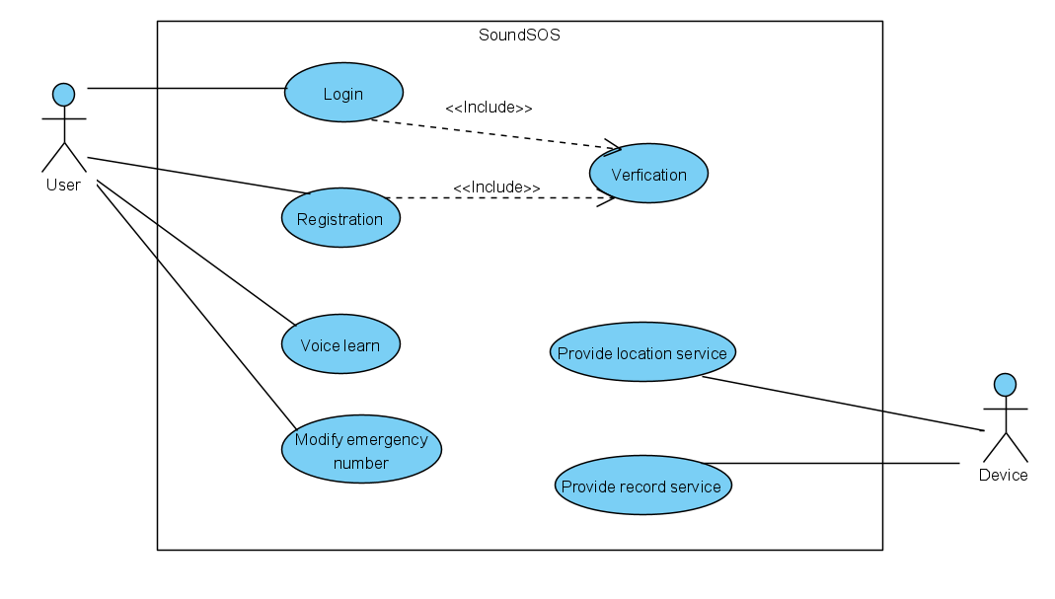
Use case

Slide 10
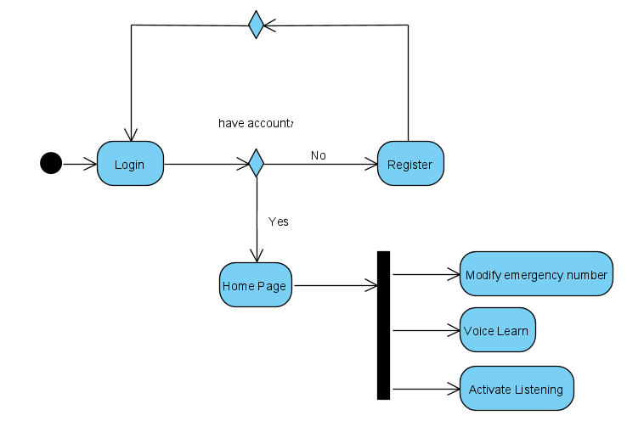
Control FLOW

Slide 11

Challenges
Make it available by phone.
Creating a user-friendly application.
Creating an automation record.
Application runs in the background.

Slide 12

Demo

Slide 13

Evaluation /Verification
Expected result | Test case | Test
Error message | Incorrect field type and press Submit button | 1
Correct message | Correct field type and press Submit button | 2
Go to ‘Home Page’ screen | Press back button | 3
Go to ‘Login screen’ | Press ‘Logout’ | 4
Turn on the listening | Enter ‘ON’ (Home Page) | 5
Turn off the listening | Enter ‘OFF’ (Home Page) | 6
Connection with DB | Connection with DB (server side) | 7
Connection with client | Connection with client (server side) | 8

Slide 14
Conclusion
In our application, we have developed a novel feature for voice learning, which involves the use of a multi-layer CNN model.
This model has been specifically designed to address two tasks: unique voice classification and emotion voice classification.
By leveraging the power of convolutional neural networks, we aim to accurately classify voices based on their unique characteristics and emotional attributes.

Slide 15

Thank you for listening

